Slide 1
Search space
and
brute force
If all you have is a hammer, everything looks like a nail

Slide 2
Search Space
Ensemble of all solutions we have to choose from to get the optimal answer
Often what is asked from us is not the solution but one of its properties

Slide 3
Search Space on an example : minimum pair
Find the minimum pair on the list IE the pair with the minimum sum
0 5 8 6 -1 4 9 10 2
Search space : all the pairs

Slide 4
Make sense of your search space
Another representation :
Matrix where
line : first element of the pair
Column : second element
Implementation : two for loops
 | 0 | 5 | 8 | 6
0 | ----- | 5 | 8 | 6
5 | 5 | ----- | 13 | 11
8 | 8 | 13 | ----- | 14
6 | 6 | 11 | 14 | -----

Slide 5
Brute force - introduction
Example: I want to find all subsets of a set which sum is 42
I can:
make a list of all subsets
for each subset, calculate the sum and check if it is 42
Search space: all subsets of the array
Test: the sum is 42
A brute force search has a search space and a test

Slide 6
Brute force - construct the search space
The python module itertools provides useful tools to construct the search space. See https://docs.python.org/3/library/itertools.html
>>> list(product("ab", "cd"))
[('a', 'c'), ('a', 'd'), ('b', 'c'), ('b', 'd')]
>>> list(permutations("abc", 2))
[('a', 'b'), ('a', 'c'), ('b', 'a'), ('b', 'c'), ('c', 'a'), ('c', 'b')]
>>> list(combinations("abc", 2))
[('a', 'b'), ('a', 'c'), ('b', 'c')]
>>> list(combinations_with_replacement("abc", 2))
[('a', 'a'), ('a', 'b'), ('a', 'c'), ('b', 'b'), ('b', 'c'), ('c', 'c')]
Note: we use list() because the return values are lazy-evaluated iterables
→ these are very useful to save memory

Slide 7
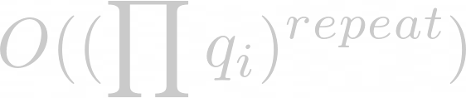
Quick tour of theses functions
product(q₁,q₂,...,[repeat=1])
Can take multiple iterables and output the cartesian product between them
The repeat field indicate how many time do we take the iterables
Complexity :
Where q_{i} is the size of each iterable

Slide 8
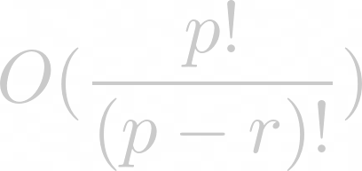
Quick tour of theses functions
permutation(p, [r=len(p)])
Take an iterable and create every permutation of length r
A permutation is an ordered (order is important) of element without repetition
Complexity : For example with r=2, the complexity is p*(p-1)
Where p is used as the size of the iterable p

Slide 9
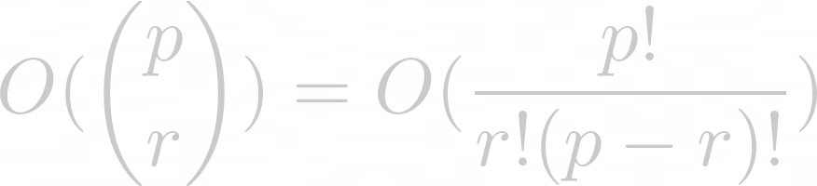
Quick tour of theses functions
combinations(p, r)
Take an iterable and create every combination of length r
A combination is a non ordered of element without repetition, since it is non ordered, AB and BA are the same
Complexity :
Where p is used as the size of the iterable p

Slide 10
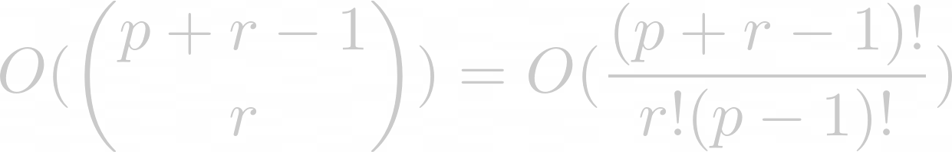
Quick tour of theses functions
combinations_with_replacement(p, r)
Take an iterable and create every combination of length r with replacement
Same as combination, but we can repeat the same element multiple times
Complexity :
Where p is used as the size of the iterable p

Slide 11
Brute force - let’s solve our example
from itertools import combinations
arr = [int(n) for n in input().split()]
gen = (sub for size in range(len(arr))
for sub in combinations(arr, size))
for sub in gen:
if sum(sub) == 42:
print(sub)
IN:
10 12 25 30 17 8 14 9 6
OUT:
(12, 30)
(25, 17)
(25, 8, 9)
(10, 12, 14, 6)
(10, 17, 9, 6)
gen is Python magic called a generator expression. Ask me if you want to know more.

Slide 12
Why not to use brute force
There is a problem called combinatorial explosion
Cf https://en.wikipedia.org/wiki/Combinatorial_explosion
Tl; dr: the search space is often a lot bigger than the input size (e.g exponential)
Previous example: for an array of size n, there are 2^n - 1 non-empty subsets…

Slide 13
Why not to use brute force
Brute force is a good way to test if more complicated algorithms are correct (you compare their results on small sets)
Sometimes you just don’t know a better algorithm
But, can’t we reduce the search space a little bit?
→ often you can use backtracking

Slide 14
Backtracking
Stop it, before it’s too late !

Slide 15
Backtracking - introduction
5 | 3 | 4 | 6 | 7 | 8 | 9 | 1 | 2
6 | 2 | 7 | 1 | 9 | 5 | 3 | 4 | 8
1 | 9 | 8 | 3 | 4 | 2 | 5 | 6 | 7
8 | 5 | 9 | 1 | 6 |  |  |  | 3
4 |  |  | 8 |  | 3 |  |  | 1
7 |  |  |  | 2 |  |  |  | 6
 | 6 |  |  |  |  | 2 | 8
 |  |  | 4 | 1 | 9 |  |  | 5
 |  |  |  | 8 |  |  | 7 | 9
We need to reduce the search space
Example: sudoku
Try to fill the sudoku
Everytime you encounter a conflict, change the last number
If no number is ok, erase and change the previous one
etc

Slide 16
Backtracking - concepts
The idea of backtracking is to:
build the elements of the search space incrementally
eliminate wrong partial solutions → and therefore all solutions that contain them
You can think of the search space as a tree, you will often use a recursive function
E.g for sudoku, each level of the tree corresponds to a empty cell in the grid
→ the size of the search space is 9^n but many cases can be discarded

Slide 17
Implementation of a backtracking sudoku solver in Python
def is_valid(grid, i, j, val): line = grid[i] column = [grid[k][j] for k in range(9)] square = [grid[3 * (i // 3) + k][3 * (j // 3) + l] for k in range(3) for l in range(3)] return not (val in line or val in column or val in square) def backtracking(grid, i, j): if i == 9: return True nexti, nextj = (i if j < 8 else i + 1), (j + 1) % 9 if grid[i][j] != 0: return backtracking(grid, nexti, nextj) for val in range(1, 10): if is_valid(grid, i, j, val): grid[i][j] = val if backtracking(grid, nexti, nextj): return True grid[i][j] = 0 return False
grid = [list(map(int, input().split()))
for _ in range(9)]
if not backtracking(grid, 0, 0): print("Impossible") else: print("\n".join(" ".join(
map(str, grid[i]))
for i in range(9)))

Slide 18
Implementation of a backtracking sudoku solver in Python
IN:
5 3 0 0 7 0 0 0 0
6 0 0 1 9 5 0 0 0
0 9 8 0 0 0 0 6 0
8 0 0 0 6 0 0 0 3
4 0 0 8 0 3 0 0 1
7 0 0 0 2 0 0 0 6
0 6 0 0 0 0 2 8 0
0 0 0 4 1 9 0 0 5
0 0 0 0 8 0 0 7 9
OUT:
5 3 4 6 7 8 9 1 2
6 7 2 1 9 5 3 4 8
1 9 8 3 4 2 5 6 7
8 5 9 7 6 1 4 2 3
4 2 6 8 5 3 7 9 1
7 1 3 9 2 4 8 5 6
9 6 1 5 3 7 2 8 4
2 8 7 4 1 9 6 3 5
3 4 5 2 8 6 1 7 9
Partial candidates explored: 6428
Total size of the workspace: 8,86293812×10²¹

Slide 19
Credits
Slides: Louis Sugy, Arthur Tondereau
Sudoku sample: Wikipedia

